Slide 1


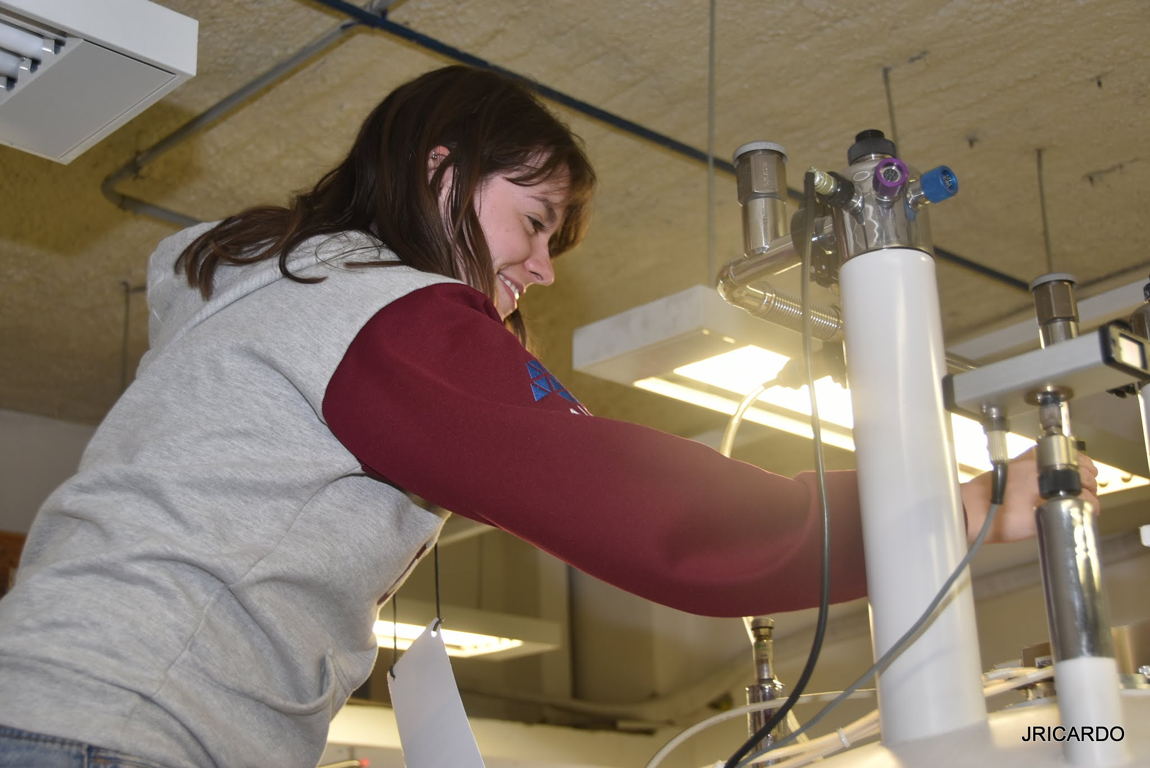
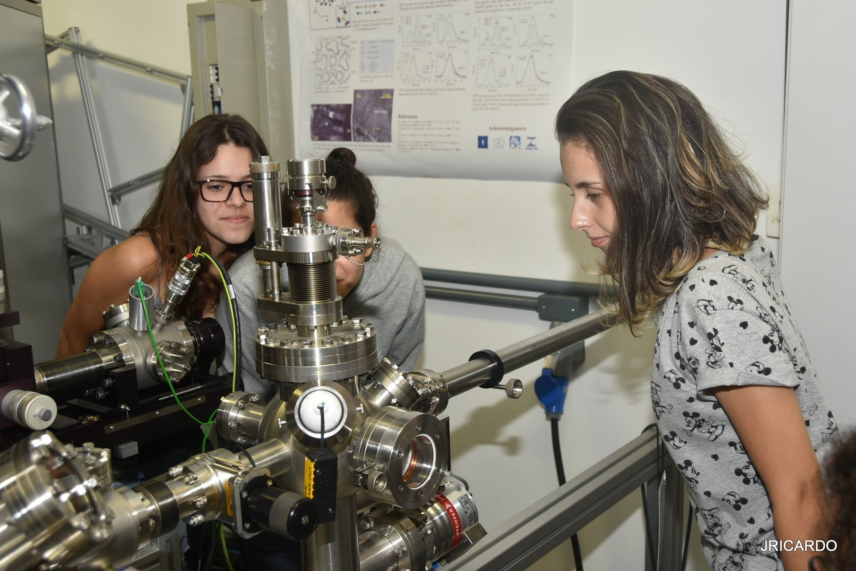
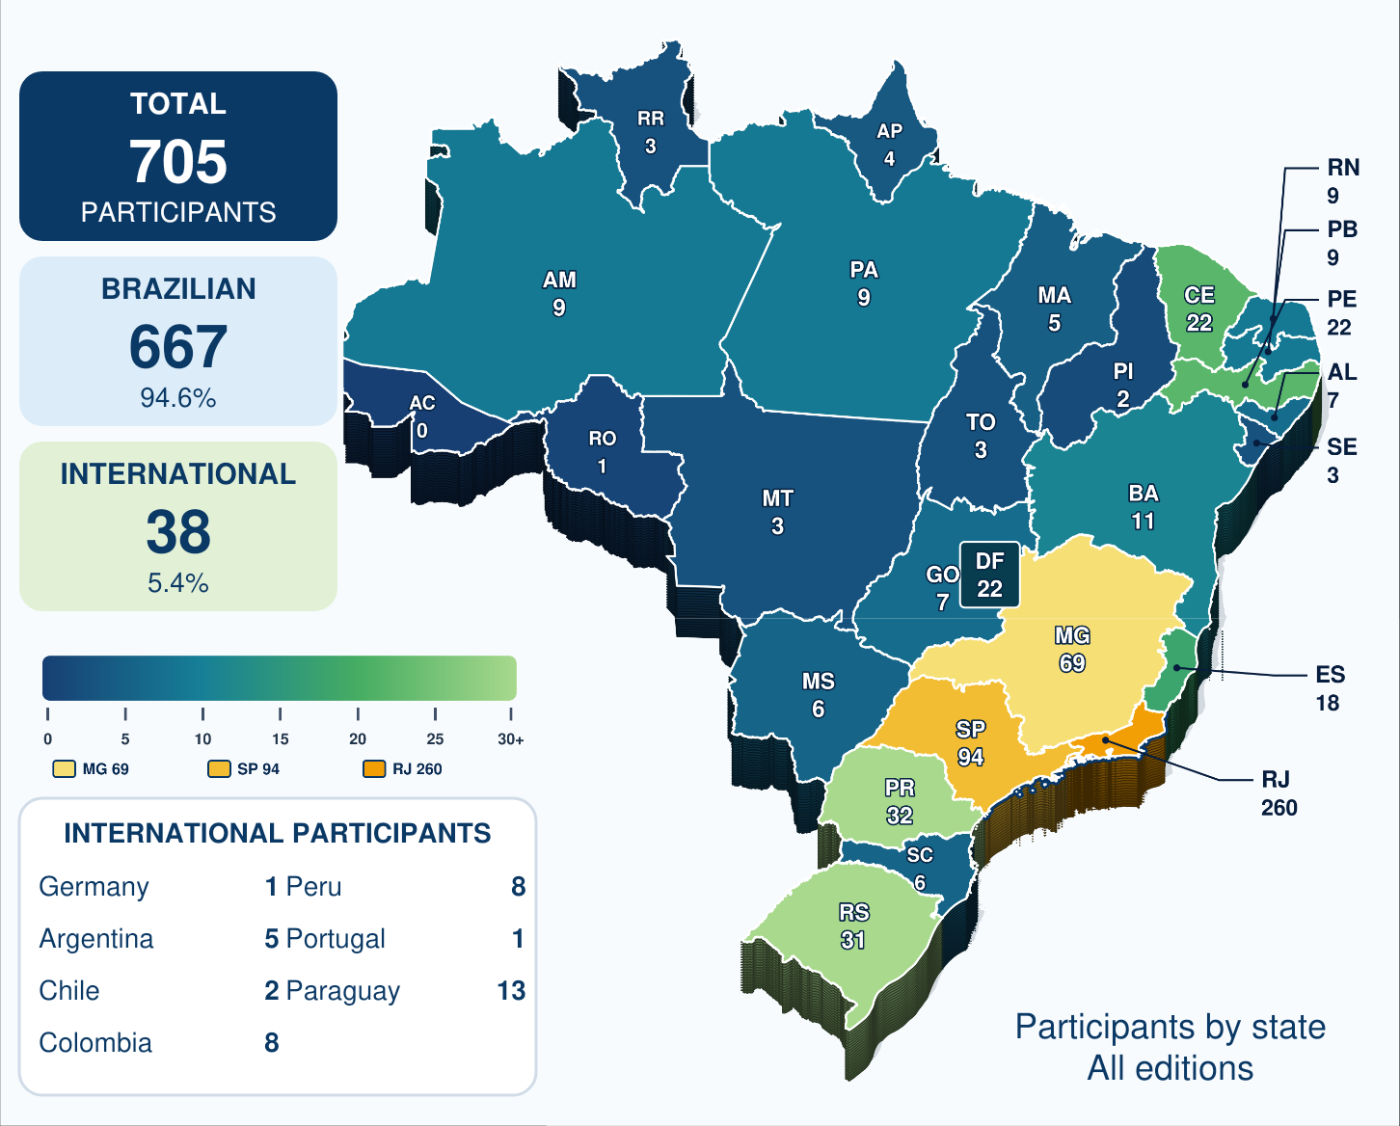
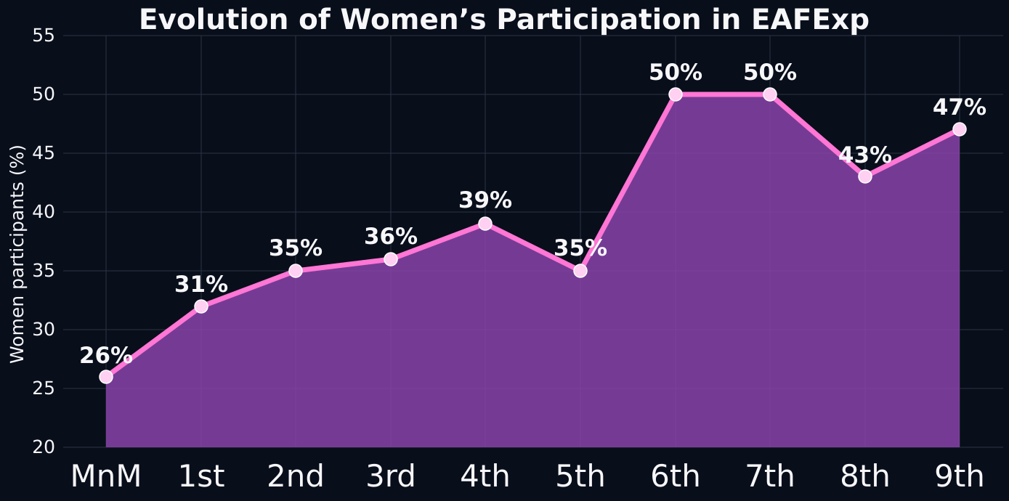
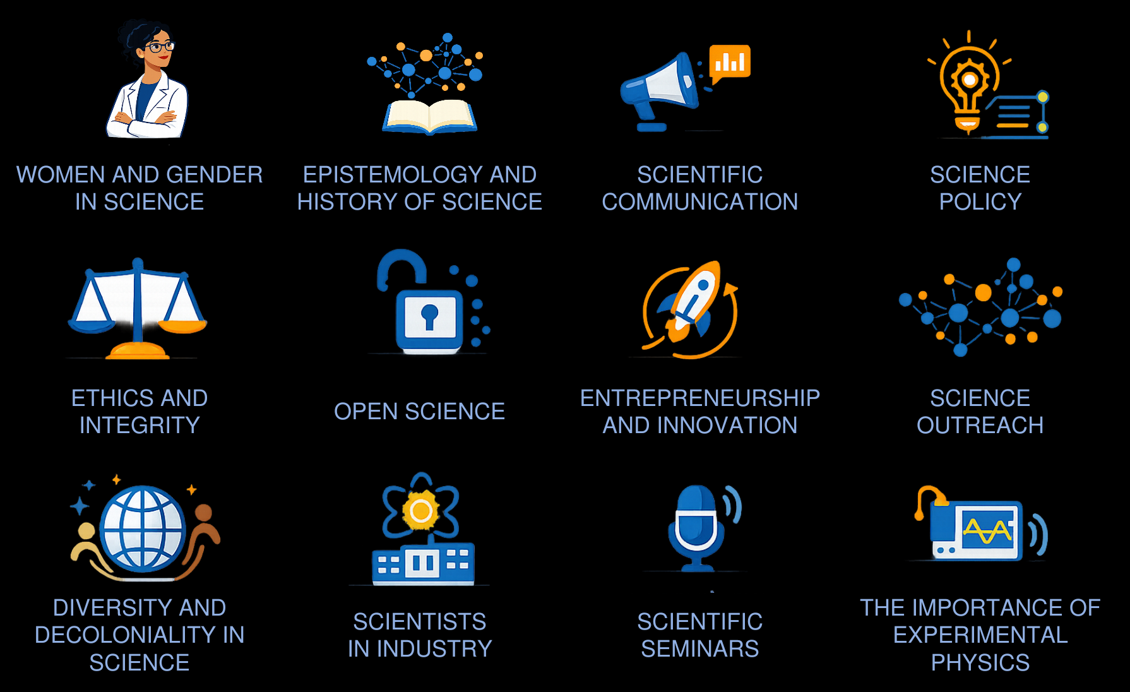
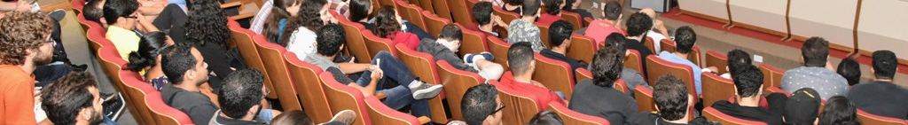
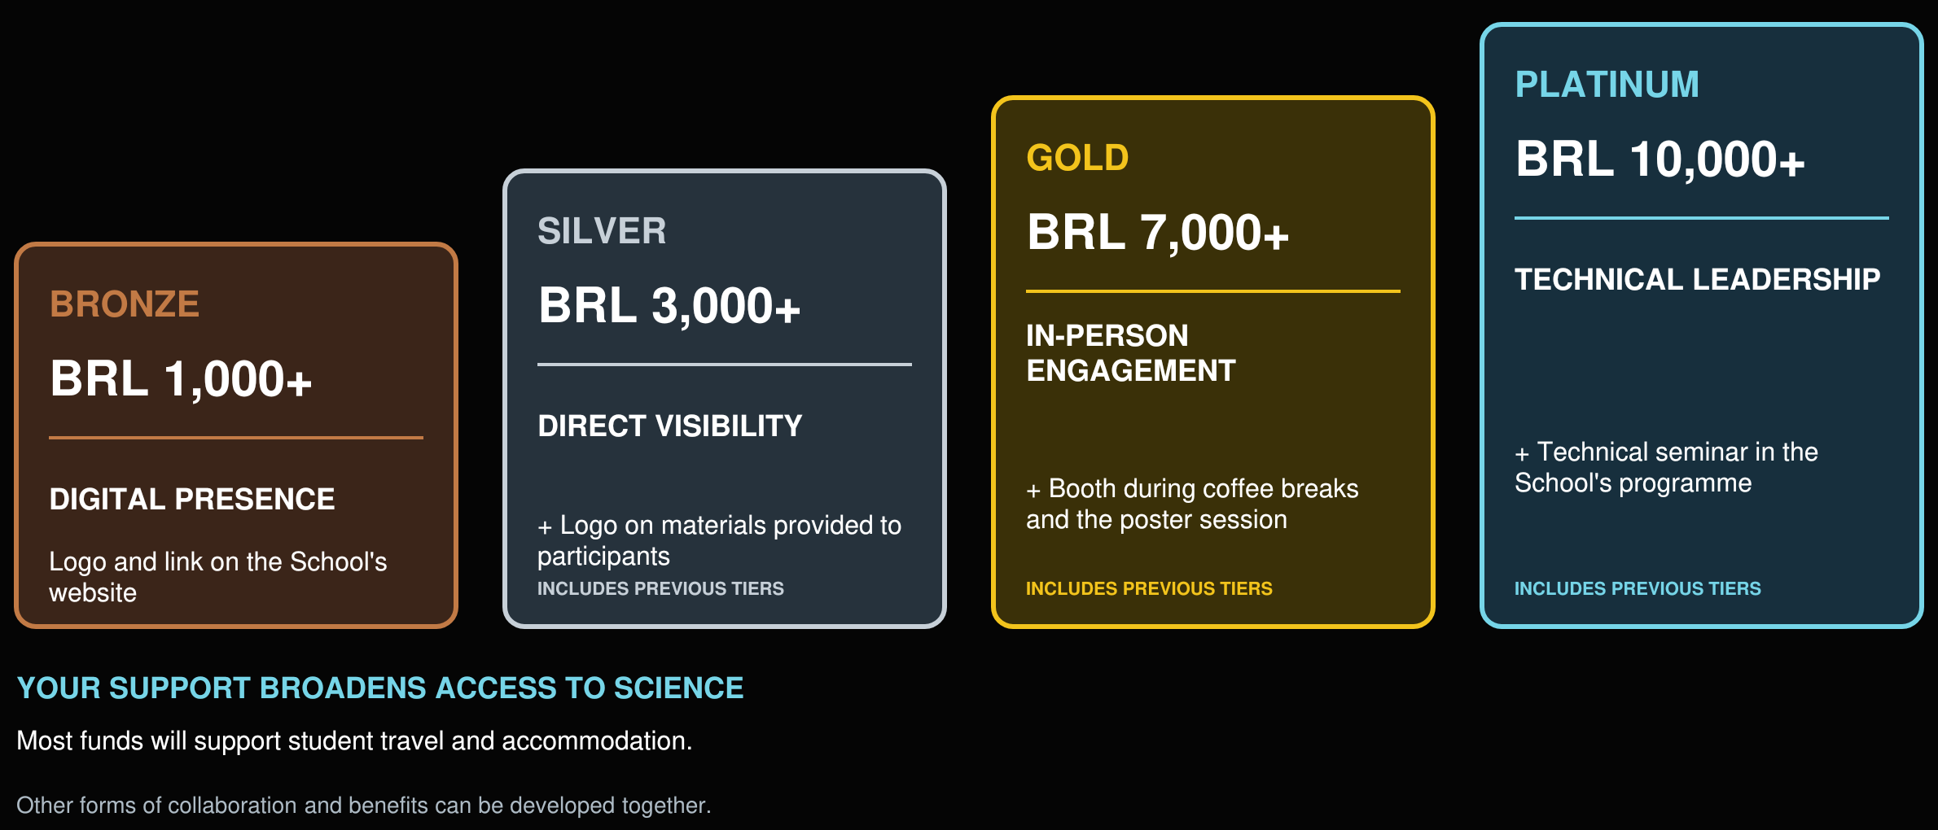





IMMERSIVE, DIVERSE TRAINING
Experimental science
that transforms careers
SPONSORSHIP OPPORTUNITIES
Over 10 years advancing hands-on experience, nationwide reach, and international impact.
FULLY HANDS-ON TRAINING
Learning science with state-of-the-art instrumentation
During two immersive weeks, students operate advanced equipment, tackle real problems, and analyze results alongside researchers. This direct experience connects laboratories with solutions offered by partner companies and prepares future users of scientific instrumentation.
1
Understand
the scientific question
2
Explore
techniques and instruments
3
Analyze
data and uncertainty
4
Communicate
results and learning
NATIONWIDE REACH
A diverse, connected scientific community
The School welcomes students from every region of Brazil and from other Latin American countries—many from institutions far from major research centers, with limited access to advanced laboratories.
705
attendees
100+
Brazilian universities
26
states + Federal District
38
international participants
Regional and cultural diversity enriches the training, expands exchange, and builds lasting scientific networks.
DIVERSITY AND WELL-ROUNDED TRAINING
More women, broader perspectives, stronger science
Women’s participation grew from 26% to 50% across the School’s editions.
Ethics, integrity, communication, science policy, entrepreneurship, and outreach complement the experimental training.
DIRECT IMPACT
Your support removes barriers to participation
BRL 300,000
Most sponsorship funds will support travel and accommodation for students from distant regions, reducing barriers while preserving the School’s broad reach and inclusive character.
estimated cost of this edition
ACCOMMODATION
throughout the two weeks
TRAVEL
for students from distant regions
COMMUNITY
academic and cultural
LOGISTICS
laboratories and activities
PARTNERSHIP
Four ways to make a difference
Cumulative benefits • choose the level of visibility for your brand
HELP US WRITE THE NEXT DECADE OF THIS STORY
Align your brand with an educational, far-reaching, and diverse initiative — and connect your solutions with current and future users of advanced scientific instrumentation.
Notes:
[Sources]
- Apresentação 10EAFExp_Patrocinio(3).pptx, fornecida pelo usuário: identidade visual, textos, fotografias, gráfico e indicadores.
- IBGE, Malha Municipal Digital 2025: geometria cartográfica do mapa.
- Folder ICHEP 2026, indicado pelo usuário: referência editorial para formato vertical contínuo.
[Sources]
Diversity layout restored exactly from the user-cited 10th_EAFExp_Sponsorship_Flyer_EN_Final.pptx, with original chart, captions and audience photograph. The English formation panel is from the user-consolidated 10th_EAFExp_Details_English.pptx, slide 10. Other current consolidated figures, wording, and clickable approved contact stickers retained.
[/Sources]

