Slide 1


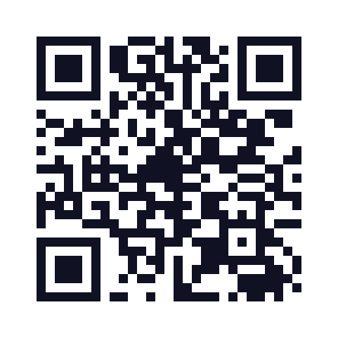
Advanced School of
Experimental Physics
15–26 February 2027
CBPF, Urca, Rio de Janeiro, Brazil
11 experimental modules
Two weeks of research in the laboratory
For undergraduate and graduate students
in physics and related fields
APPLICATIONS
15 Sep – 15 Oct 2026
eafexp.cbpf.br
Notes:
10th Advanced School of Experimental Physics at CBPF. In-person activities take place from 15 to 26 February 2027 in Urca, Rio de Janeiro, Brazil. Applications run from 15 September to 15 October 2026. The School welcomes undergraduate and graduate students in physics and related fields, from institutions in Brazil and abroad. Eleven experimental modules are offered; each participant joins one module throughout the two weeks.
Information and applications: https://eafexp.pages.cbpf.br/2027/en/
Contact: eafexp@cbpf.br
Sources: the School website supplied as 2027-main(3).zip; original illustration and logo supplied by the user; APRESENTAÇÃO EAFEXP 10_Identidade Visual(6).pdf. Visual identity: Carlos Henrique Viviani and Claudia Fleury, Amperdesign.

